Slide 1
Introduction to Database
Programming with Python
Gary Stewart
gstewart@cs.uct.ac.za

Slide 2
Persistent Data
Many software solutions require persistent data, i.e. data stored permanently
There are many ways to have data persist
  text files, e.g. comma delimited files
  object binary files, e.g. using pickle
  databases, e.g. sqlite3

Slide 3
Databases
A database, or Database Management System (DBMS) manages persistent data
The DBMS allows data storage, retrieval, privacy, security and integrity
There are many commercial and open source examples
  Commercial - SQL Server, Oracle, MS Access
  Open Source - MySQL, Postgresql, sqlite

Slide 4
Types of Databases
There are various kinds of DBMSs, e.g.
  object oriented DBMSs
  no-SQL DBMSs
  relational DBMSs
  object-relational DBMSs
Most commonly used systems are Relational Database Management Systems (RDBMS)

Slide 5
Relational DBMSs
Relational DBMSs store sets of data in a tabular format, which are typically related to each other
The data is manipulated with a language called SQL (Structured Query Language)
These RDBMSs work very similarly
Most RDBMSs are client-server based
Examples
  SQL Server, Oracle, MySQL, PostgreSQL

Slide 6
Tables, Records, Fields
In a RDBMS data is typically stored in a tabular format in tables, or relations
Each table has fields, or attributes, which indicate what is stored in each column
The table also has many records, or tuples, which indicate what is stored in each row

Slide 7
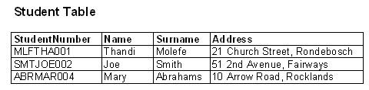
Example
The following example is of a Student table
It has fields for StudentNumber, Name, Surname, Address
It contains 3 records for particular students
field
record

Slide 8
Field Data Types
When creating a new table the data type for each field needs to be specified
RDBMSs have many data types relating to integers, real or floating point numbers, strings or text, images, etc.
Field data types can also be further constrained with size, precision, etc.

Slide 9
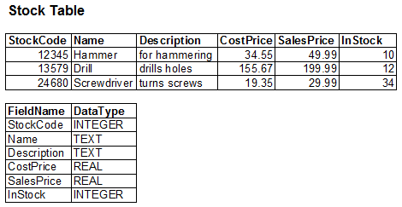
Example
The following example is of a Stock table with fields and corresponding datatypes

Slide 10
Primary Keys
When defining a table, it is useful to specify a field (or set of fields) which uniquely identifies a record
This unique identifier is referred to as the primary key
The primary key is typically an id number or unique code which identifies a record

Slide 11
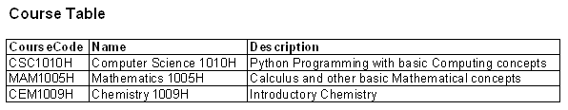
Example
The following example is of a Course table
primary key

Slide 12
Relationships
RDBMSs allow the definition of relationships between data, as they occur in the real world, e.g.
  Students and Courses
  Employees and Branches
These relationships can have different cardinalities, depending how one record in a table relates to another record in the related table, e.g.
  one to one
  one to many
  many to many

Slide 13
Foreign Keys
These relationships are indicated by using the primary key of the related table
When the primary key of a table is used in another table to specify the relationship, it is referred to as a foreign key

Slide 14
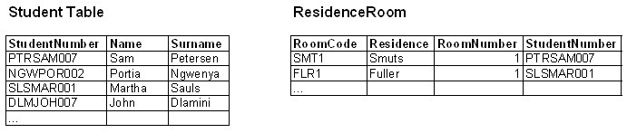
Example
Consider Student and ResidenceRoom tables
A one-to-one relationship exits between Student and ResidenceRoom
foreign key

Slide 15
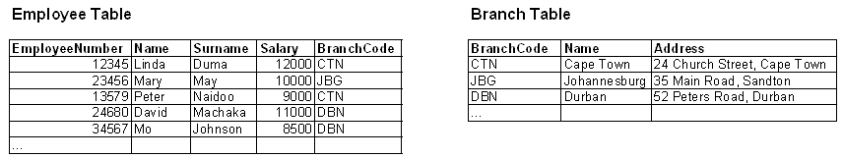
Example
Consider Employee and Branch tables
A one to many relationship exits between Branch and Employee
foreign key

Slide 16
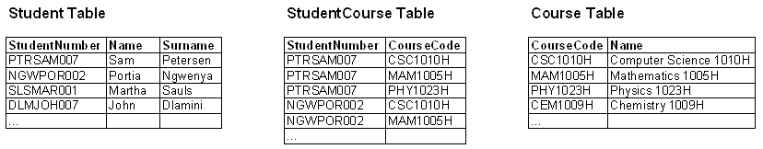
Example
Consider Student and Course tables
A many to many relationship exits between Student and Course
An extra StudentCourse needs to be created
foreign keys

Slide 17
Relationships
Cardinalities are expressed using foreign keys
  one to one, the “subset” table contains a foreign key
  one to many, the many table contains a foreign key
  many to many, a new table is created to contain both foreign keys
Table relationships defined in this way avoids duplication of data

Slide 18
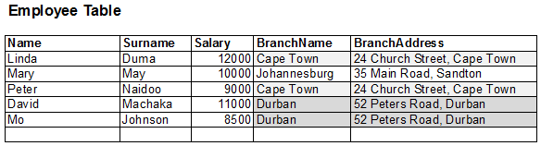
Without Relationships
A database with tables, but no keys and no relationships would duplicate information

Slide 19
sqlite
sqlite is a lightweight, server-less, open source RDBMS engine
It is the “most widely deployed SQL database engine in the world”, e.g.
  Apple computers and iphones
  Mozilla Firefox
Sqlite is unlike most RDBMSs, since the database is stored in a single file, and it is not client-server based

Slide 20
sqlite
It conforms to the basic principles of RDBMSs
Accessible by many programming languages and management tools
  Languages - PHP, Python, Java, C++
  Management Tools - SQLite Expert, SQLite Spy
The current version of sqlite is sqlite3

Slide 21
sqlite data types
sqlite has many data types, but the primary ones are the following
  text, for storing text or strings
  real, for storing floating point number
  integer, for storing integers

Slide 22
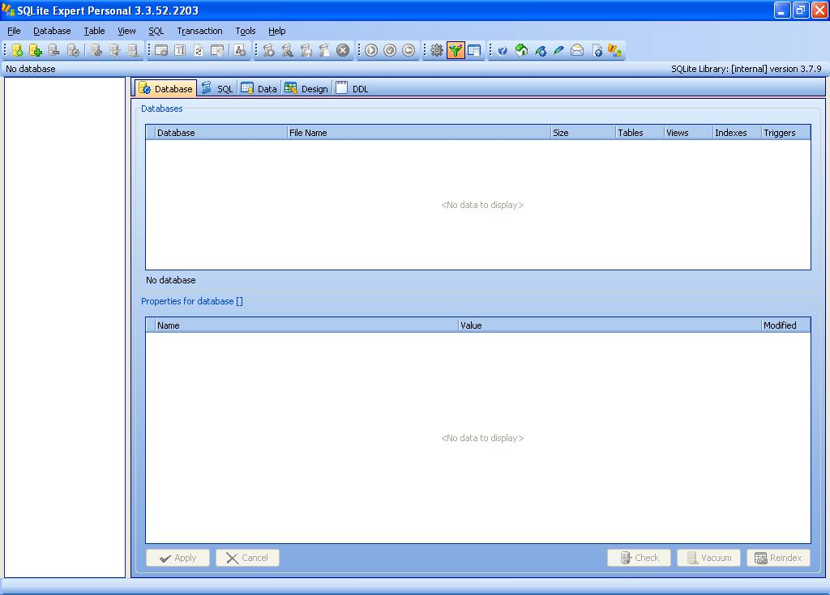
SQLite Expert
SQLite Expert Personal is a free GUI-based management tool for sqlite databases

Slide 23
SQL
Data in RDBMSs is manipulated using SQL (Structured Query Language)
Basic SQL commands:
  create, creates a table
  drop, drops/deletes a table
  insert, inserts a record into a table
  update, updates fields in a table record
  delete, deletes records from a table
  select, selects data from a table

Slide 24
SQL: create and drop
The create SQL command creates a new table
    create table <table> (<field1> <datatype1>,…)
When creating a table the field names and their data types need to be specified
    create table Person (Name text, Age integer)

Slide 25
SQL: drop
The drop SQL command deletes a table
    drop table <table>
When dropping a table only the table name is specified
    drop table Person

Slide 26
SQL: insert
The insert SQL command insert records
into a table
    insert into <table> values (<value1>,…)
When inserting the values need to be specified in order
    insert into Person values (“John Smith”, 20)

Slide 27
SQL: delete
The delete SQL command deletes records from a table
    delete from <tablename> where <fieldname> = <value>
The delete command has a where clause to indicate which records to delete
    delete from Person where Name = “Kim Jones”

Slide 28
SQL: update
The update SQL command updates fields
in a table record
    update <table> set <field1> = <value1> where <field2> = <value2>
The update command has a set clause to
indicate which fields to update
The update command has a where clause to indicate which record to update
    update Person set Age=21 where Name=“John Smith”

Slide 29
SQL: select
The SQL select command selects data from a table
    select <field1>,… from <table> where <fieldx> = <value>
The field names to select can be specified explicitly, or * for all fields
    select Name, Age from Person
    select * from Person

Slide 30
SQL: select
The select command can have a where clause specifying which records to select
    select Age from Person where Name = “John Smith”

Slide 31
Multiple SQL Commands
When using multiple SQL statements each statement needs to end with a semi colon ;
  create table Person (Name text, Age integer);
  insert into Person values (“John Smith”, 20);
  update Person set Age=21 where Name=“John Smith”;
  select * from Person;

Slide 32
Python and sqlite3
Python has a module which enables it to manipulate sqlite3 databases
    import sqlite3
A sqlite3 database is created using the connect() function and specifying a filename
    db = sqlite3.connect(‘my_database.db’)
An SQL command can be executed by calling the execute method
    db.execute(‘create table Person (name text, age int)’)

Slide 33
Python and sqlite3
When executing an insert statement it is possible to use the ? notation as placeholders for the values and pass the values in a tuple
    db.execute('insert into Person values (?,?)',('bob',20))

Slide 34
Python and sqlite3
If the SQL command(s) modifies the database the commit() method needs to be called for the command to take effect
    db.commit()
Committing can be done after a set of commands
Committing is necessary for the following SQL commands to take effect
  create,insert,update,delete,drop

Slide 35
Python and sqlite3
When executing a SQL select command the execute() method returns a cursor which can be iterated over with a for loop to access the records returned
    cursor = db.execute(‘select * from Person’)
    for row in cursor:
    print(row)
Each row/record is returned as a tuple

Slide 36
Databases in Development
Databases are commonly used in the typical software development process on many platforms – desktop, web, etc.
Usually the database is first designed with tables, relationships, etc. with a management tool
Then a software application is developed which interacts with the database

Slide 37
Resources
sqlite
  www.sqlite.org
SQL
  www.w3schools.com/sql
Python and sqlite3
  Python reference documentation

